Slide 1
PROJECT PROPOSAL REAL CHECK
- ROUNAK NAYEE RUTGERS UNIVERSITY
MS Computer Science

Slide 2
What is Counterfeiting ?
Counterfeiting and duplication are one of the greatest dangers to an organization, affecting it’s revenue, brand image as well as end consumers.
The rise of e-commerce platforms has made it easier for counterfeiters to reach a global audience, complicating monitoring and enforcement. The sale of counterfeit goods can fund other illegal activities, such as organized crime or even terrorism.
Counterfeit products, especially pharmaceuticals, cosmetics, and food items, may not undergo proper safety checks, putting consumers at risk.

Slide 3
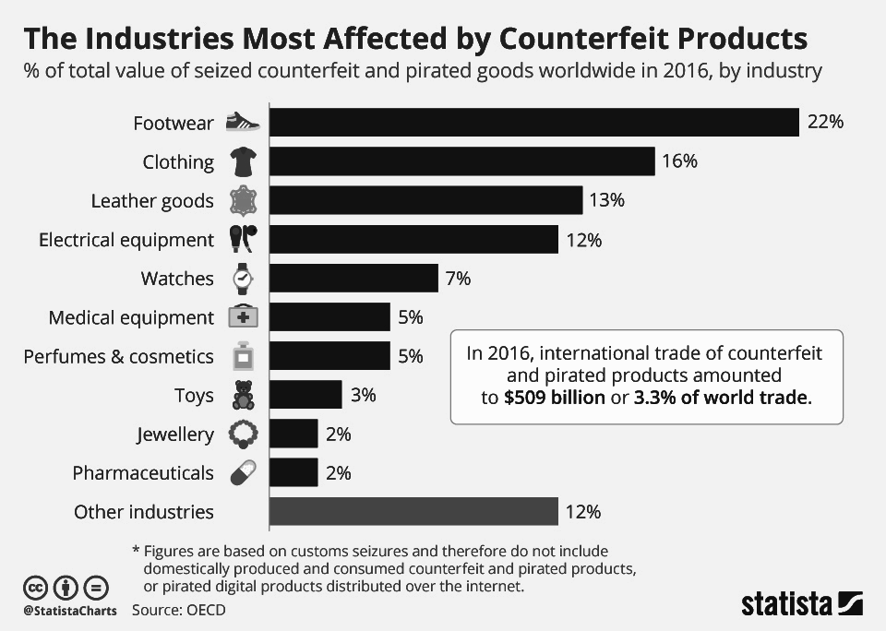

Slide 4
The Problem
Counterfeited items, let alone customers, the manufacturers themself are unable to distinguish between the fake and real products. The digital e-commerce landscape, makes detection and mitigation increasingly challenging. There's a pressing need for a transparent, tamper-proof, and universally verifiable system to ensure product authenticity, protect brands, and instill confidence as well as ensure safety within customers.

Slide 5
What is the Solution !
Traceability and transparency is the key to achieving this. Blockchain is a decentralized and distributed digital ledger used to record transactions across multiple computers, ensuring data integrity and transparency through cryptographic techniques.
The manufacturer embeds the serial/QR/Bar code onto the product as well as the chain and at every distribution it is updated with information, the consumer can verify whether the product is fake or not. Anyone attempting to add a counterfeit item would not be able to modify the chain.

Slide 6
What is Existing work ?
Traditional serial numbers and holographic Stickers which can be replicated.
QR code based product authenticity checked but often URLs are vulnerable to spoofing.
Proprietary databases where products' authentic details are stored. Retailers and customers can check against this database. However, being centralized, they are vulnerable to hacks and tampering.
Platforms where consumers can report counterfeit products, helping others avoid them.

Slide 7
Proposed improvement
Incorporate role-based access in smart contracts, ensuring only genuine manufacturers register products and give access rights to specific sellers.
Combining multiple verification methods (like bar/QR codes and blockchain), the system provides a multi-layered approach to product verification along with geolocation details.
Engage consumers in the verification process, optionally rewarding them for valid counterfeit reports and automated reporting to manufacturers.

Slide 8
PROPOSED SYSTEM
MANUFACTURER*
DISTRIBUTORS / SELLERS*
CONSUMERS*
AUTHENTICATE
BLOCKCHAIN
*All Users would have their individual custom endpoint for system access viz. Manufacturer, Distributors / Sellers and Consumers

Slide 9
TECHNICAL PLAN
FRONT END
WEB / MOBILE APPLICATION
SCANNER INTERFACE
BACK END
APPLICATION SERVER
DATABASES
BLOCKCHAIN LAYER
SMART CONTRACTS
BLOCKCHAIN APIS FOR TRANSACTIONS
HOSTING
CONTAINERIZATION
CI / CD

Slide 10
EXPECTED PROJECT TIMELINE
WEEK 1-2
WEEK 3-4
WEEK 5-6
WEEK 7-8
WEEK 9-10
PLANNING
UI / TECH STACK
BOTTLENECKS
DEVELOPMENT
DEVELOPMENT - DEPLOYMENT
RE-ITERATE
TESTING
TEST / ROLLOUT
REPORT

Slide 11
REFERENCES
Shubham Prajapati, Jayesh Gadhari, Tushar Sawant, Juilee Kini, Sheetal Solanki, "Strengthening Supply Chain Integrity with Blockchain-based Anti-Counterfeiting Measures", 2023 International Conference on Innovative Data Communication Technologies and Application (ICIDCA), pp.786-790, 2023
V. Buterin, “A next-generation smart contract and decentralized application platform.," Available online at: https://ethereum.org/en/whitepaper/
A. Lewis, ”A gentle introduction to smart contracts," Available online at: https://bitsonblocks.net/2016/02/01/a-gentle-introduction-to-smart-contracts/
https://www.statista.com/chart/17410/counterfeit-and-pirated-products-by-category/
W Viriyasitavat, D Hoonsopon “Blockchain characteristics and consensus in modern business processes”, Journal of Industrial Information Integration 13, 32-39

Slide 12
GOAL
"To develop a decentralized and transparent system leveraging blockchain technology to authenticate and verify product authenticity, thereby combating counterfeiting and reinforcing trust among consumers, manufacturers, and sellers."

Slide 13
Thank You!

